Slide 1


A Tool for Automated Earthquake Response
November 12-13, 2013
Eric A. Herman, GISP
NY State Thruway Authority

Slide 2
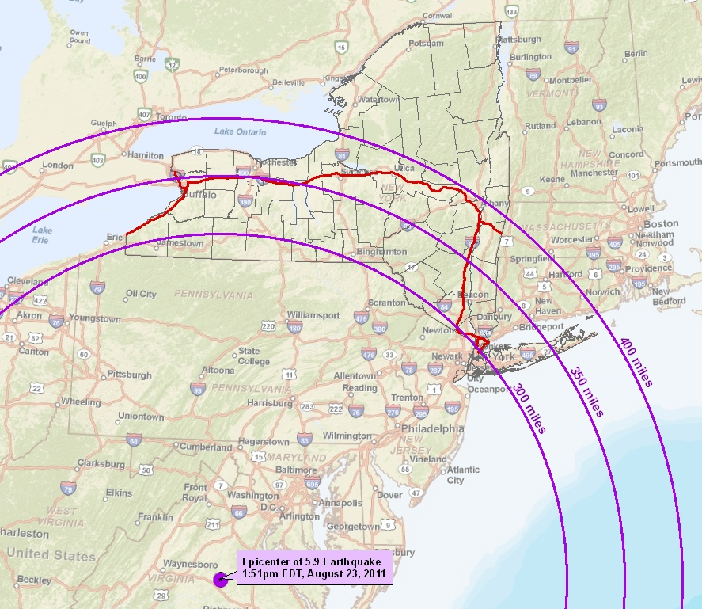
One day in 2011…

Slide 3
Reaction
  Duty officers and bridge inspectors were subscribed to USGS earthquake notifications
      Overkill – Within just a few months, this resulted in frustration, with risk of apathy
  New strategy needed
    Quickly see where quake is/how we’re impacted
    Limit to only relevant earthquakes
    Make accessible from home & mobile
    Easy/intuitive for non-GIS users

Slide 4
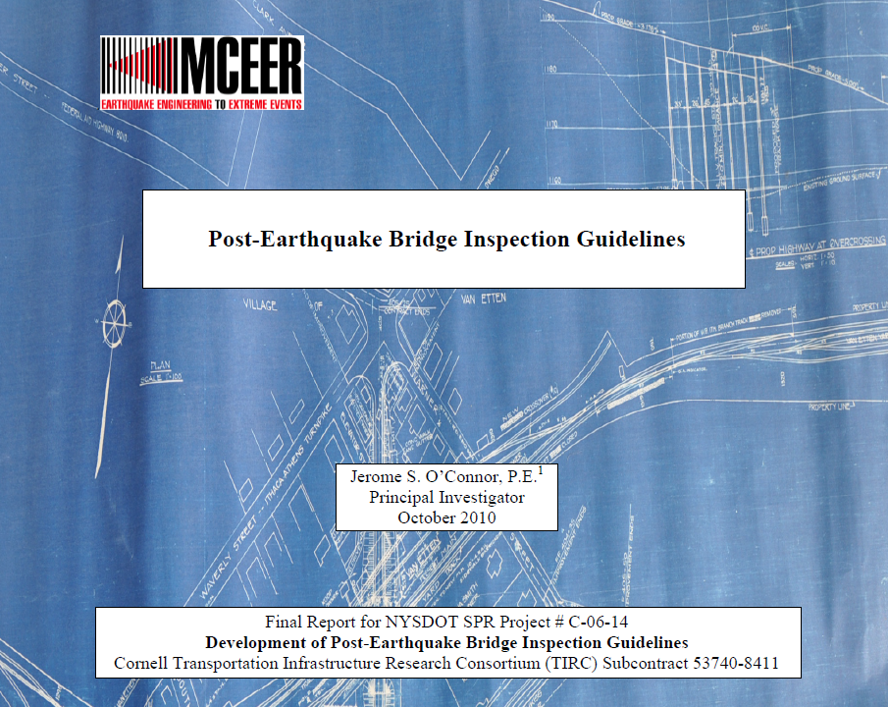
Simplifying a Complex Issue
  Earthquake propagation too complex for fast, detailed modeling
  Guidelines developed by the Multidisciplinary Center for Earthquake and Engineering Research simplify this:
    3.5 – 4.4: 40 miles
    4.5 – 5.4: 60 miles
    5.5+: 80 miles
  Additional inspections/ reviews may be requested
  3.0 is minimum humans sense

Slide 5

What the Application Does
  Polls USGS website for new earthquakes every 15 minutes
  Downloads quakes that meet specific location and magnitude criteria:
        Within approximately 200 miles of NYS >= 3.5
        Northeastern portion of country >= 4.5

Slide 6
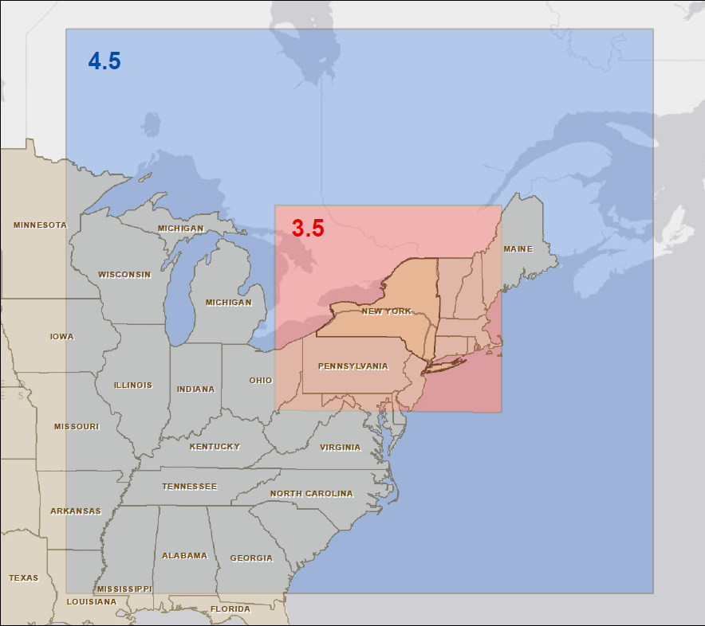

Slide 7
Let’s Take a Look…

Slide 8
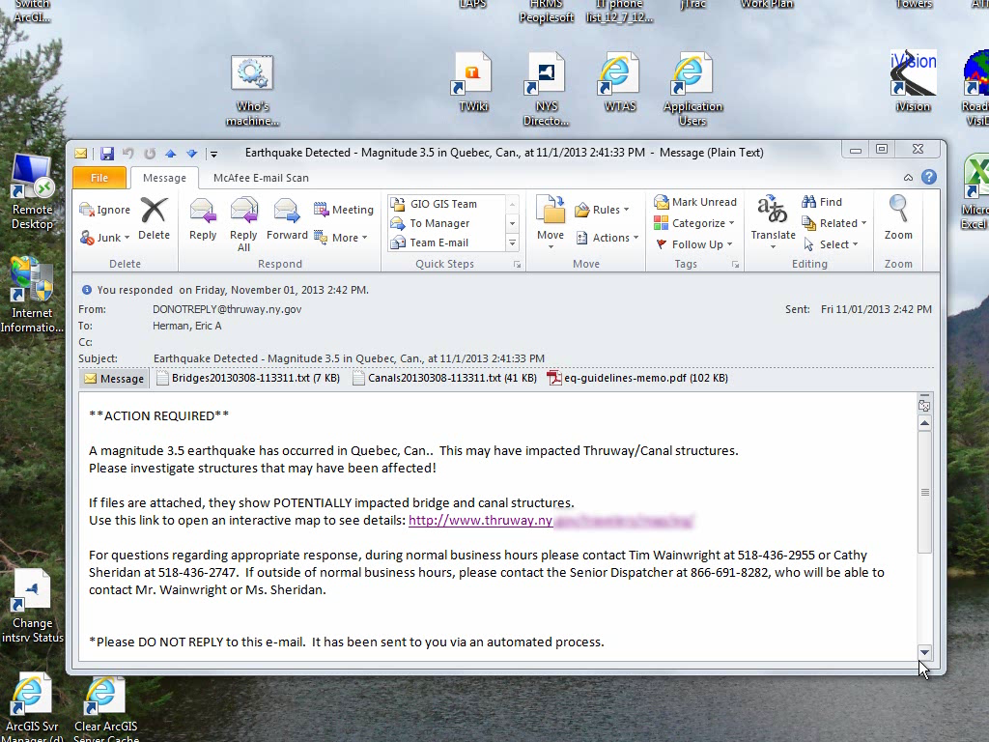

Slide 9
How Does it Work?
  Scheduled task runs a Python script
      Downloads latest quake data that meets criteria & converts to feature class (Script from Esri’s Paul Dodd)
      Uses ArcGIS to identify features from geodatabases (bridges, dams, etc.) within the appropriate distance
      Geodatabase features converted to KML, and added to custom Google Map interface (created in-house, using Google Maps API)
  VBScript sends email, provides a link to map & attaches lists of potentially impacted infrastructure
Thanks to Jay Holbrook & Chris Fatato!!

Slide 10
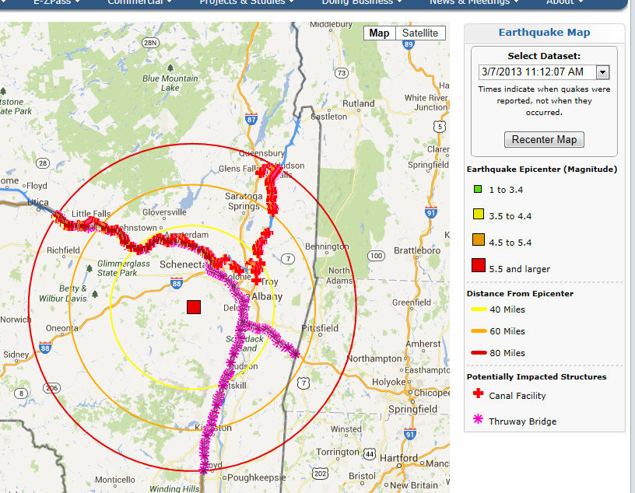
The Map Interface
  Google Maps provides familiar interface/navigation
  Color-coded epicenters match required inspection buffers
  Relevant facilities shown (can click for detail)
  Can click on epicenter, to get quake info
  Most recent quake is the
  default (older are viewable)
  May see more than one quake with aftershocks

Slide 11

The Results so Far…
  Far fewer alerts sent out
  Very well-received interface
  Much happier customers
  BUT
  No big earthquakes yet…

Slide 12
Questions?
Eric A. Herman, GISP
eric.herman@thruway.ny.gov

