Slide 1
NYS Orthoimagery ROI Ray Faught – NYS ITS GPO NYGeoCon 2013
“I would not be able to complete my tasks within a reasonable time frame without the orthoimagery.”
“I honestly don't know how I would have been able to be as effective managing from afar without the orthoimagery.”
“Some tasks currently performed using orthoimagery would otherwise require field work, saving hours if not days of labor, if the project would be undertaken at all.”
“Incredibly useful in dealing with the public as a visual aid. Most of my property owners are impressed with the imagery.”
“Going out into the field would be the only way to get the information without orthoimagery, greatly increasing the time & cost of the project.”
Notes:
Hello. I’m Ray Faught from the Office for Information Technology Services. I’m speaking today on our project to study the value of New York State’s orthoimagery program. These quotes are but a few of the many positive comments we attempted to translate into dollars for our return on investment study. Our program has been going strong for over 12 years with consistent quality.

Slide 2
Some Basic Facts - NYSDOP
Regular updates since 2001 to present
Partial coverage of NYS annually
Trusted base layer for data development and GIS
Widespread distribution
Web Mapping Services -http://www.orthos.dhses.ny.gov/ArcGIS/rest/services
Notes:
Roughly a quarter of the State has been updated every year since 2001. The orthoimagery has served as a trusted, high-resolution, and spatially accurate base layer for data development and other (GIS) activities. Our imagery is widely distributed; to the individual counties as well as State and Federal Agencies on external hard drives and the general public through our website with direct download capabilities and an interactive mapping application. In 2008 our imagery was available as a web mapping service from USGS EROS Data Center, and now continues to be available from our own servers, both as WMS and Rest Endpoints.

Slide 3
Some Basic Facts - NYSDOP
All imagery flown in spring – leaf off
Rigorous QA/QC
Accuracy +- 4 ft. horizontal for 1 ft. and ½ ft.
Accuracy +- 8 ft. horizontal for 2 ft.
Checked by NYS DOT photogrammetry unit
Further quality review by GPO
Upgrades available in coverage and resolution
Notes:
The photography is always captured in spring, leaf off. The accuracy is checked by NYS DoT Photogrammetry section to meet strict accuracy standards. In the history of the program, as I can recall, the RMS error is usually half of the specified accuracy. The quality of the imagery undergoes further review in our office and corrections are made before the imagery is accepted and delivered. Currently, the base product is 2ft GSD in the rural areas and 1ft GSD in the urban areas. Optional upgrades are available such as complete coverage of 1 ft. for a county, or an upgrade in resolution in urban areas from 1 ft. to half ft.

Slide 4
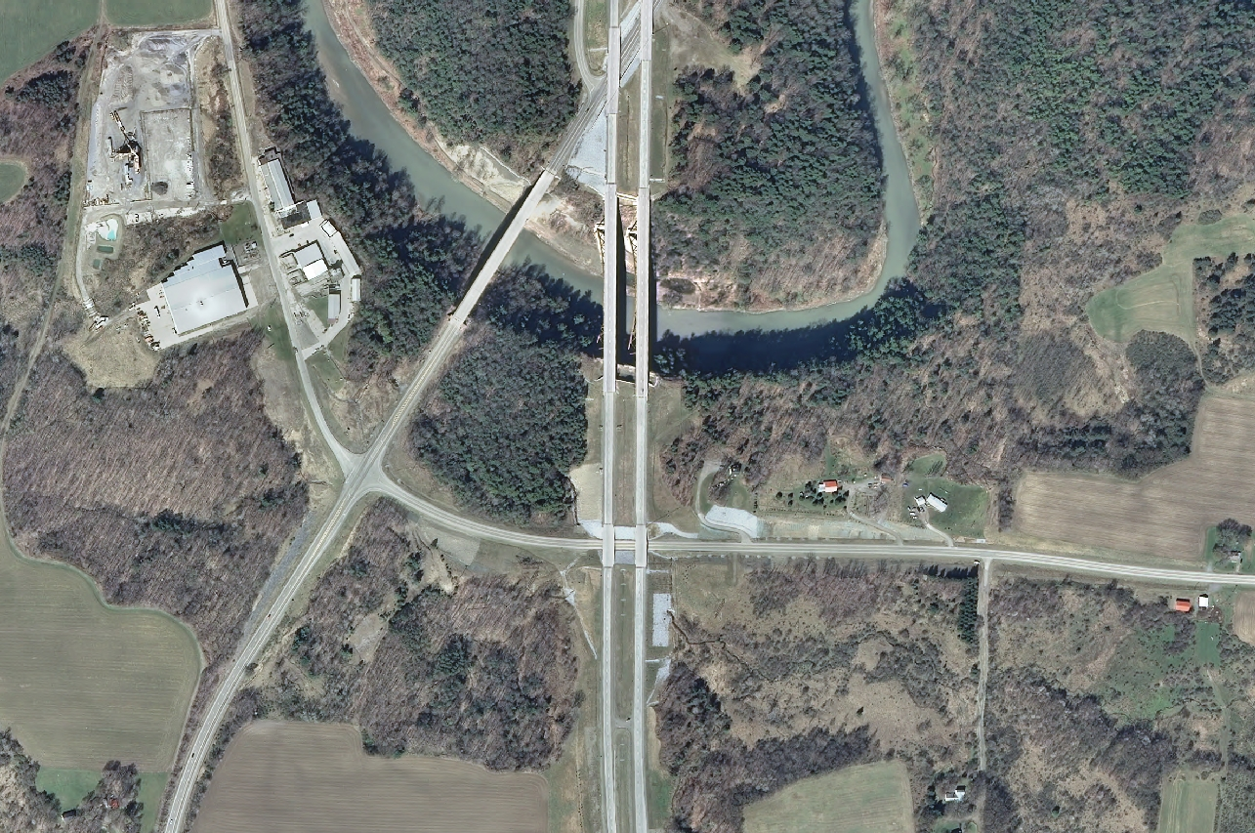
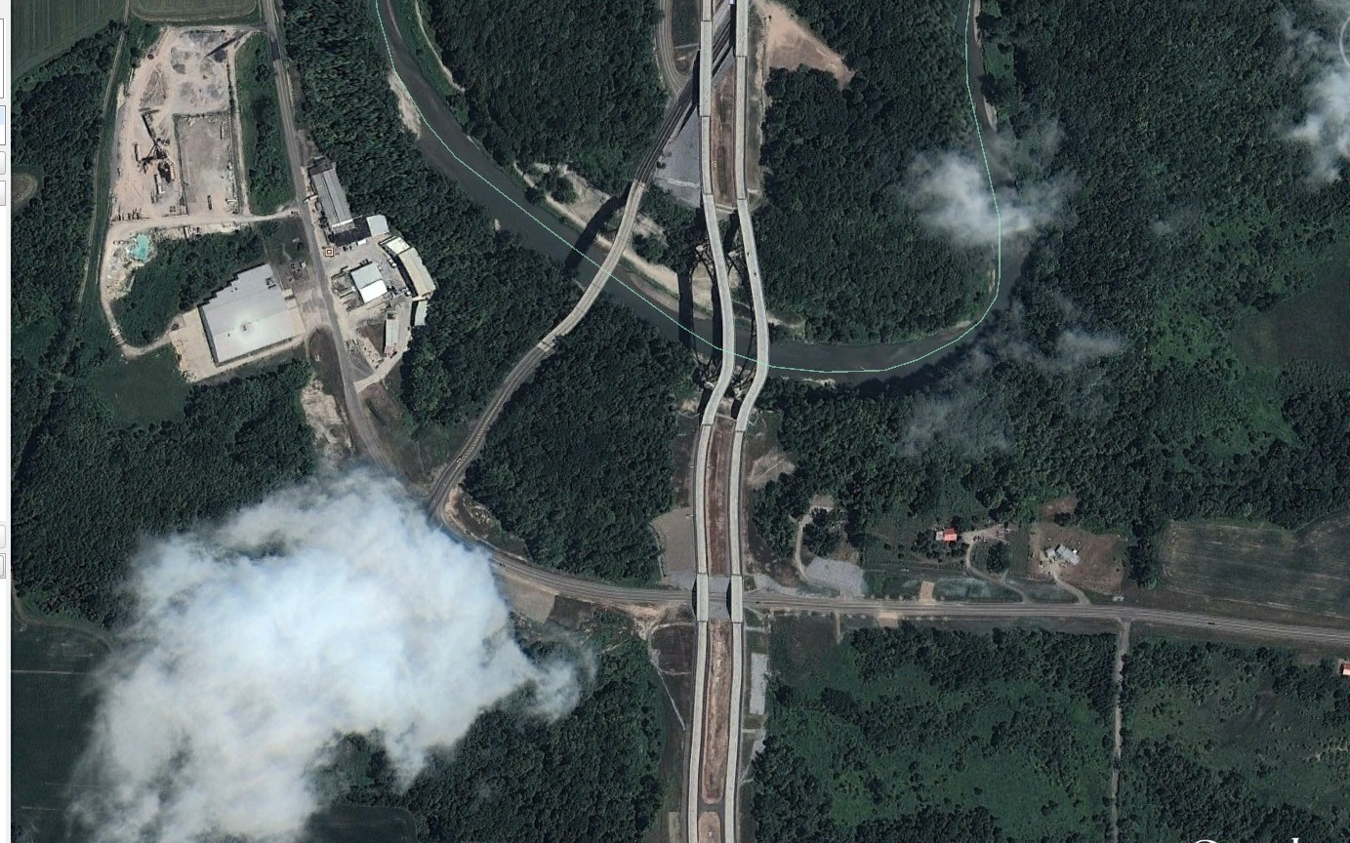
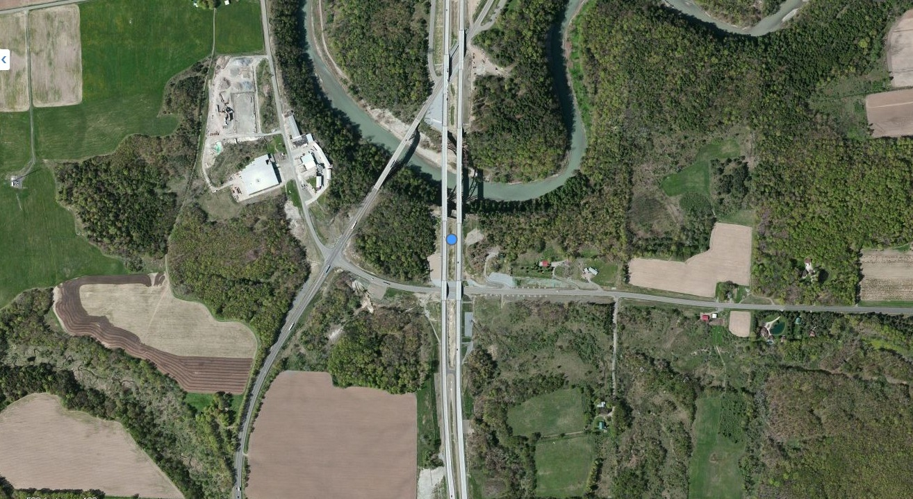
Why NYSDOP?
Flown in spring
Leaf off
Rectified, accurate
Cloudless
Notes:
In our surveys and conversations, the question of other sources of imagery has been raised. There are a few drawbacks to using other sources, beside the ability to use them in GIS software. Some online imagery has obvious distortion and clouds as well as full leaf out. The NYSDOP imagery is leaf off and fully rectified to remove terrain distortion. Other online imagery is good in this area, but not always the case as the next slide will show.

Slide 5
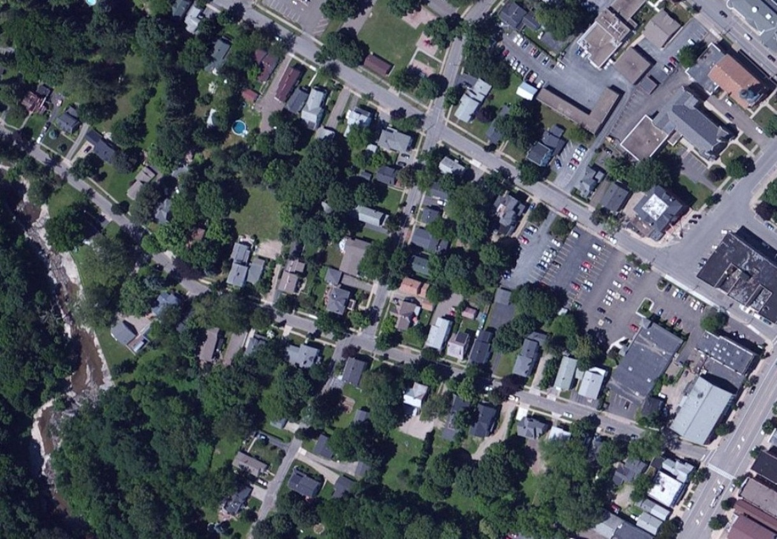
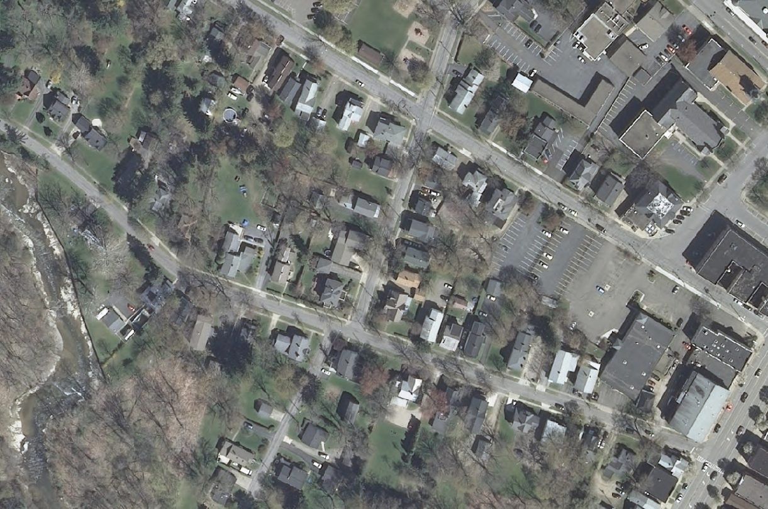
Notes:
Remember the leaf on or off question. Which version will give the user the best view?

Slide 6
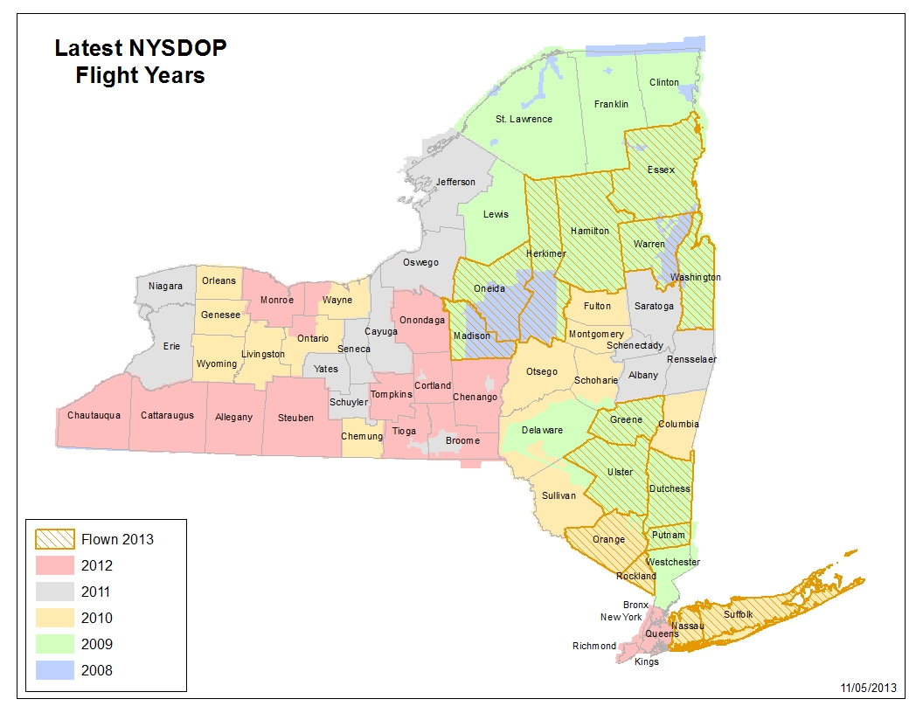
Notes:
This is the overview of the current vintages of imagery available statewide. Every year, where we fly is dependent on vintage of imagery, additional funding sources such as county upgrades and federal funds for more frequent urban area updates. Since 2006, we have flown New York City every 2 years. Currently, every county in the state has been flown at least 3 times.

Slide 7
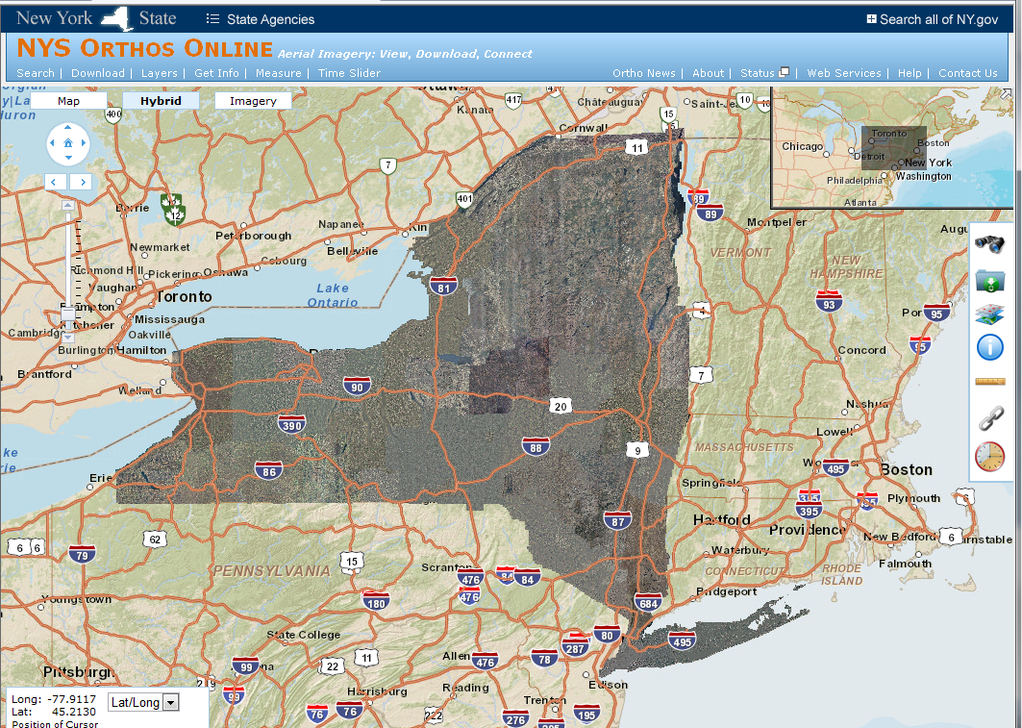
Notes:
This is our website where all vintages of imagery can be viewed and downloaded, starting with the statewide coverage of the 1990’s NAPP photography up to our most recent 2012 4-band imagery

Slide 8
Orthoimagery: How Valuable?
We always knew our program was valuable
Applied for NSDI CAP Grant for study of ROI
Compare COSTS of program to BENEFITS
Methodology developed by GITA
Use of detailed spreadsheets and calculations to determine ROI
Notes:
We are proud of our program for it’s wide distribution and quality. We knew it must have value, but we didn’t know how valuable and we didn’t know to what extent the imagery was used. To prove the value to ourselves and as well as justify our program in the face of shrinking budgets and funding sources, we applied for a grant to do a Return on Investment study through the National Spatial Data Infrastructure Cooperative Agreements Program. We were trained in October 2011 on the GITA (Geospatial Information & Technology Association)procedures and worksheets to undertake the study. Essentially we needed to show that for every dollar spent on the orthoimagery, multiple dollars were returned to our investors: ultimately the taxpayers.

Slide 9
Scope of Study
Six year duration: 2006 - 2011
Costs – we have detailed information
Benefits - sample of PUBLIC sector and PRIVATE sector
Rockefeller Institute of Government engaged for private sector research, calculations and report
Notes:
Since we used all digital photography in 2006 to the present and all color for 1ft and 2ft., no more panchromatic, we decided to use 2006 to 2011 for our study period. We would study a sample of public and private sector benefits to come up with a positive return on investment. We contracted with the Nelson A. Rockefeller Institute of Government to help with the study. They would do the research in the private sector, do the calculations in the numerous spreadsheets and write and publish the report, with our input of course.

Slide 10
ROI Scorecard
Agency/Sector | Value
NYSDOP (cost) | -$13,398,222
BENEFIT | $12,345,600
BENEFIT | $3,456,789
Net Value | ?
Notes:
We know the overall cost of the program, including salaries of our staff, and DOT staff along with all payments to the vendor for imagery and intermediate deliverables. This is an exact amount, while most of the benefits of the program can only be estimates. I’ll keep this format and add the benefits as we proceed.

Slide 11
Public Sector ROI Data Collection
15 counties, 9 state agencies and NYC
Envisioned many face-to-face meetings
Sent document with examples of benefits
Meetings did not meet expectations
Notes:
We arbitrarily picked 15 Counties and 9 State Agencies and New York City for the public sector sample group. It seemed a manageable number and we had positive relationships with most of representatives we contacted. We set up meetings to travel to various counties in the state, some overnight. In preparation, I emailed a document listing examples of savings and benefits to our contacts. We envisioned travelling all over the state to get that information. Although the initial meetings were cordial and we took notes, we got a lot of anecdotal stories and a lot of “can’t do my job without orthos”. We didn’t get hours saved, productivity increases or monetary values. That type of information is not available at the drop of a hat. It requires research and thought. One thing we generally got was a list of contacts for follow-up.

Slide 12
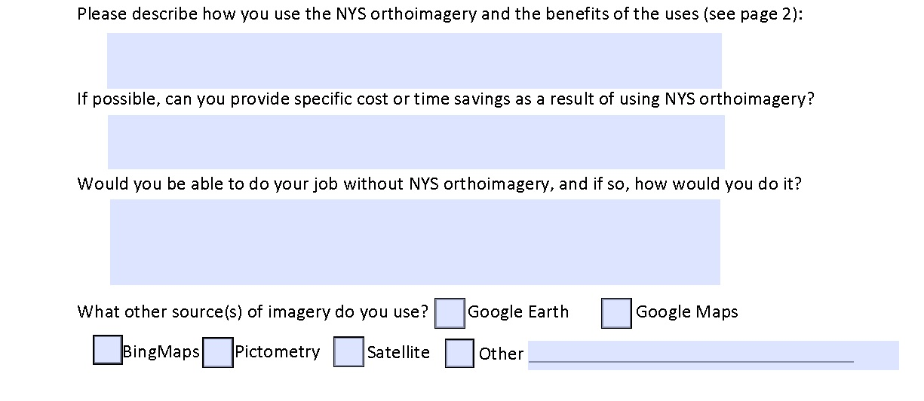
“Can’t do my job without it”
Notes:
I decided a survey could be sent in place of or as a preliminary step for a meeting. I got the idea for the survey from the State of Maine’s online orthoimagery users survey. I created a pdf survey form that could be emailed and responses sent to my email with a click of a button. CLICK - The best information came from the “essay questions”. The responses with usable dollar amounts were about 15%. With hundreds of phone calls we were able to flesh out some numbers until we got 50% or so responses with numbers. Many responses were of the type: “I can’t do my job without it, but I can’t put a price on that.”

Slide 13
Interview Leading to $$$
Saves 30 field visits per month
Hours saved (20 min/visit X 30/mo X 12mo)/60 = 120 hrs X $20/hr = $2,400/yr
Hours saved travel 15 mi @ 45mph = 20 min X 30/mo X 12mo =7,200/60 = 120 hr X $20/hr = $2,400/yr
Travel saved 15 mi/visit X 30/mo X 12 mo = 5,400 mi X $0.55/mi = $2,970/yr
$2,400 + $2,400 + $2,970 = $7,770/yr
Notes:
This is an example of results of an interview. The person I talked to estimated she saved 30 field visits per month. That alone was not enough. I phoned her and asked how long it took for a visit and how far she had to travel on average. Figuring total mileage per year @ $.55/mile and so many hours at $20/hour gave me a dollar amount to feed into the spreadsheet for that county.

Slide 14
Hi Ray,
These are really ballpark estimates, since this is by no means an exact science.
We figure Upper Management saves about 3 hrs./week by being able to meet and discuss projects (in person, or intranet) with each other/elected officials/the public without leaving the office for a field meeting. If you figure an hourly rate of $65, that would save $10,140 a year ($65*3hrs*52wks).
We figure Traffic Technicians/Engineering Aides save 2 hrs./day by not having to drive all over the County to field check locations. Estimate that time at about $25/hour which would save $13,000 a year ($25*2hrs*5days*52wks) per person. Multiply that by 2 positions for $26,000/year.
We also save Laborer costs since we overlay work order data on aerial photos (i.e. traffic sign locations, etc.). This really speeds up field installations because they see exactly where the engineer wants the traffic control device, pavement markings, etc. placed. That estimate is 2 hrs./day at $20 which would save
$10,400 a year ($20*2hrs*5days*52wks).
We guesstimate we save 200 miles/day on vehicle travel. Call it 10 gallons * $3.50/gal * 249 work days = $8,715.
And lastly, although we didn’t calculate a number, we do save on ink/paper/toner because we view everything on the intranet, or print-screen to pdf or PowerPoint. No more plotter prints on Architectural D paper, just to have a discussion.
In all that saves about $55,255/year.
Hope this helps.
Laura
$10,140 a year ($65*3hrs*52wks)
$13,000 a year ($25*2hrs*5days*52wks)
$10,400 a year ($20*2hrs*5days*52wks).
about $55,255/year
Notes:
Sometimes it was easier; the initial survey response was that the value of the orthos equaled 2 automobiles. I phoned her and asked if they would be Escalades or Yugos. We settled on her asking others in her agency to do some estimating and she came up with this detailed and excellent email response. One point to make from this is the first sentence of her email: this isn’t an exact science. The work she did on this email is the type of information we had to gather ourselves in phone interviews. When we were given a range of values we usually took the average or middle value, sometimes the low end, but never the high end estimate.

Slide 15
Public Sector Benefits
15 Counties sampled plus NYC - $24,731,386
State Agencies sampled - $17,781,289
Estimates fairly accurate
Notes:
Here’s the results of all of our phone calls with estimates of savings of time and money from often reluctant participants. Many people were afraid of making estimates and had to be assured there would be no repercussions. Many times were heard or read the phrase :“this is only an estimate”. This is true, but in most cases it is the best we can get and the users are knowledgeable enough in their own work flows to be fairly accurate.

Slide 16
ROI Scorecard
Agency/Sector | Value
NYSDOP | -$13,398,222
NET VALUE | -$13,398,222
Agency/Sector | Value
NYSDOP | -$13,398,222
15 Counties + NYC | $24,731,386
NET VALUE | $11,3331,64
Agency/Sector | Value
15 Counties + NYC | $24,731,386
9 State Agencies | $17,781,289
Total | $42,512,675
NYSDOP cost | -$13,398,222
Return | 317%
Net Value | $29,114,453
317%
Notes:
The result of our public sector research is a benefit of $42.5 million dollars, a net value of $29.1 million; A return of over 300%

Slide 17
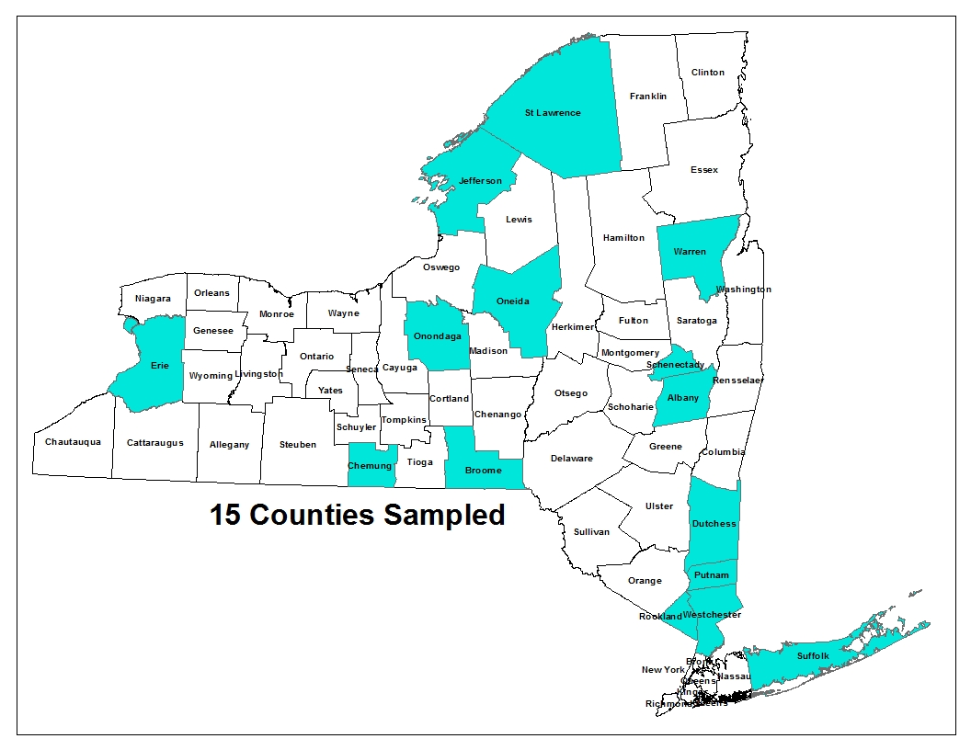
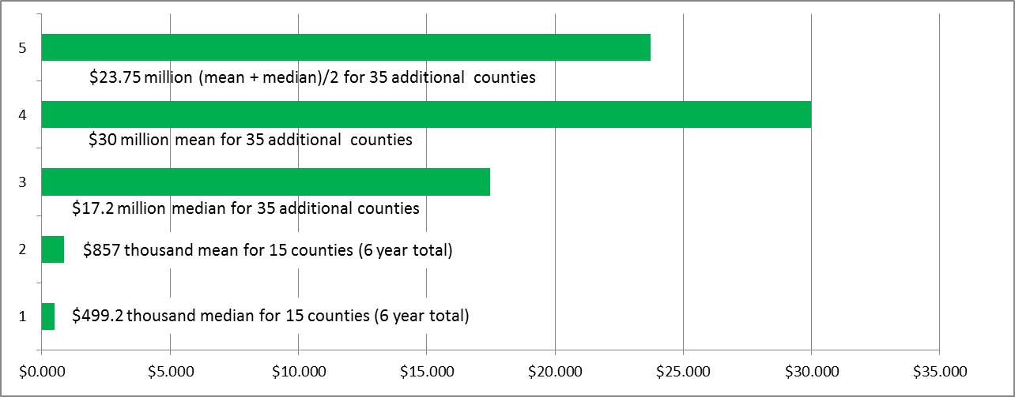
Extrapolation for Counties
Notes:
Rockefeller Institute conducted telephone surveys of all of the rest of the counties in the State NOT in the sample group and determined 35 of the remaining 42 were definitely using the New York State Orthoimagery. We have delivered imagery to all 57 counties in the State, but to remain on the conservative side, we’ll use 35 additional counties For the total six year study of the 15 counties, the median benefit was $499.2 thousand and the mean was $857 thousand. Multiplying by 35, we get 17.2 million for the median or 30 million for the mean. We’ll use $23.75 million for the 35 county 6 year total.

Slide 18
ROI Scorecard
Agency/Sector | Value
15 Counties + NYC | $24,731,386
9 State Agencies | $17,781,289
35 Counties | $23,750,000
Total | $66,262,675
NYSDOP cost | -$13,398,222
Return | 494%
Net Value | $52,864,453
494%
Notes:
Adding the average of median and mean value for the 35 additional counties we get a Public Sector benefit of $66.25 million for a net value of over $52 million. That’s almost a 500% return. This does not include numerous State and Federal Agencies who either download the imagery or receive shipments from us.

Slide 19
Private Sector Benefits
Rockefeller Institute responsible for research
Surveyors - $28.6 million
Land trusts – $0.5 million
Engineering firms
Real estate
Single county private sector – $0.5 million
Notes:
Rockefeller Institute had the responsibility for researching the benefits of the ortho program to the private sector in the State. It was decided they would cover Engineering Firms, Surveyors, Real Estate Firms and Land Trusts. They contacted many Engineering firms, but could not get an amount they were comfortable extrapolating statewide. Likewise real estate firms were not consistent in benefits. Both estimated great worth of the imagery to their professions and gave examples. They did get an estimate of 5% to 10% increase in productivity from staff at the New York State Association of Professional Land Surveyors. Using NYS Dept. of Labor statistics on the number of licensed surveyors in the state and average hourly wage and an increase in productivity of 6.25% (an amount established from multiple interviews), they calculated a total Cumulative benefit of $28.6 million dollars for the 6 year period. Getting estimates from 4 of 6 Land Trusts they contacted on productivity savings they calculated another $0.5 million. One county in our group of 15 had the survey available to the general public, where many engineers responded with savings and increased productivity. If this amount were extrapolated to all 50 counties known to use the imagery, we could add another $25 million to the total, but remaining conservative, we will not.

Slide 20
ROI Scorecard
Agency/Sector | Value
15 Counties + NYC | $24,731,386
9 State Agencies | $17,781,289
35 Counties | $23,750,000
Private Sector | $29,000,000
Total | $95,262,675
NYSDOP cost | -$13,398,222
Return | 711%
Net Value | $81,864,453
711%
Notes:
Let’s add the Private sector total of $29 million. So for an investment of $13.4 million dollars, we get benefits of over $95 million. That’s a 700% return on investment. For every dollar spent, we got back 7 dollars in benefits Remember, we didn’t contact any Federal Agencies, and only 9 out of over 70 State Agencies. Of all the entities in our sampling, we reached only a fraction of orthoimagery users, so the true benefit can only be larger than this study shows.

Slide 21
Indeterminable Benefits
Benefits that are “priceless”
Saving lives
Protecting the environment
Provide a common operating picture for:
Emergency response
Public meetings and presentations
Critical evidence in court proceedings
Notes:
In addition to all of the calculated and extrapolated benefits of orthoimagery, there are innumerable benefits that are difficult or impossible to calculate. In Dutchess County, lost hikers on the Appalachian trail called 911. Their position appeared on the dispatchers screen along with that of the rescue team searching for them. Using a grove of pine trees as a reference, the hikers and rescuers were guided by the dispatcher to each other. The imagery has been used by the Department of Environmental Conservation, the EPA and the State Attorney Generals office to prosecute violators of environmental regulations. In emergency situations, Incident management can set up staging areas and locate field operations, helicopter landing sites and so on. One County Highway Engineer commenting on using orthos for a public meeting used the ubiquitous “one picture’s worth a thousand words”. A prosecutor in a hit and run case used the orthoimagery and a GPS track of the offenders cell phone to show that he was at the scene of a hit and run accident when he claimed to be at home.

Slide 22
Probable Orthoimagery Users
Federal agencies
Real estate
Engineering firms
Private mapping firms
Orienteering
Hikers/Hunters
Nature Conservancy
Citizens
Google downloads
Notes:
I made a list of some orthoimagery users we didn’t get data on, how much more could we add to our net benefits?

Slide 23
ACKNOWLEDGEMENTS
FGDC CAP Grant (link to our report) - www.fgdc.gov/grants/2011CAP/projects/G11AC20056
GITA - www.gita.org/
Rockefeller Institute of Government - www.rockinst.org/
NYS Orthoimagery Application - www.orthos.dhses.ny.gov/
Notes:
Thank You. Thanks to FGDC for the grant and the opportunity to do this study. Thanks to G I T A for the procedures and workbooks used in the study. Thanks to the Rockefeller Institute of Government. And a link to our orthoimagery application. Click on the FGDC link above to see the final report.

Slide 24
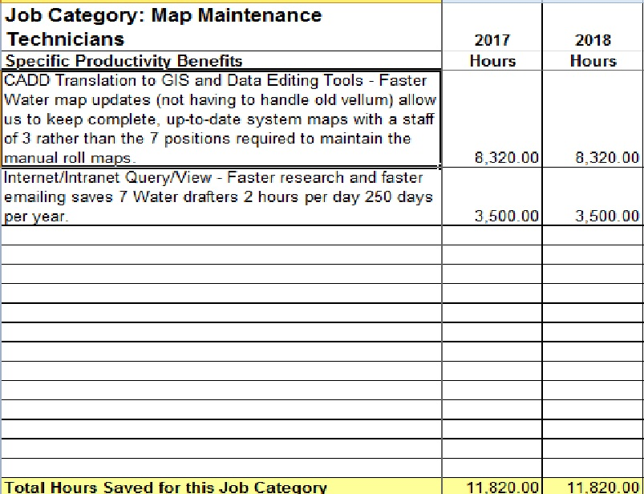
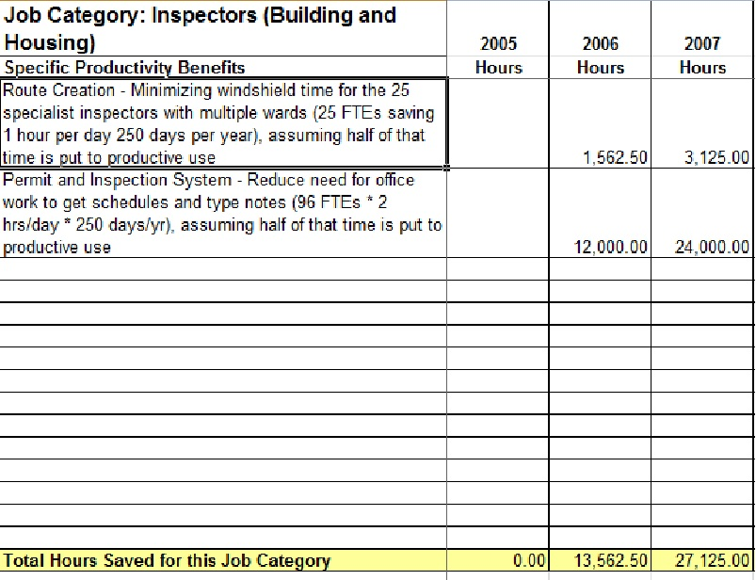
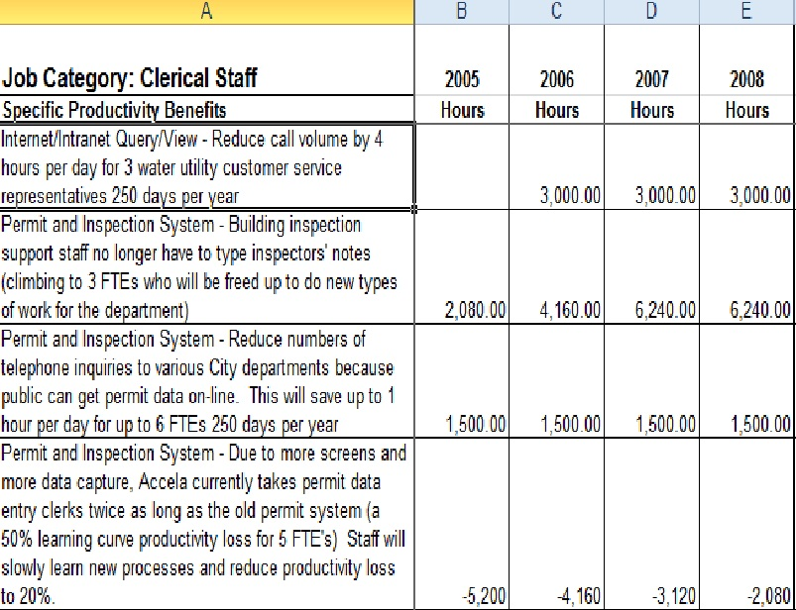
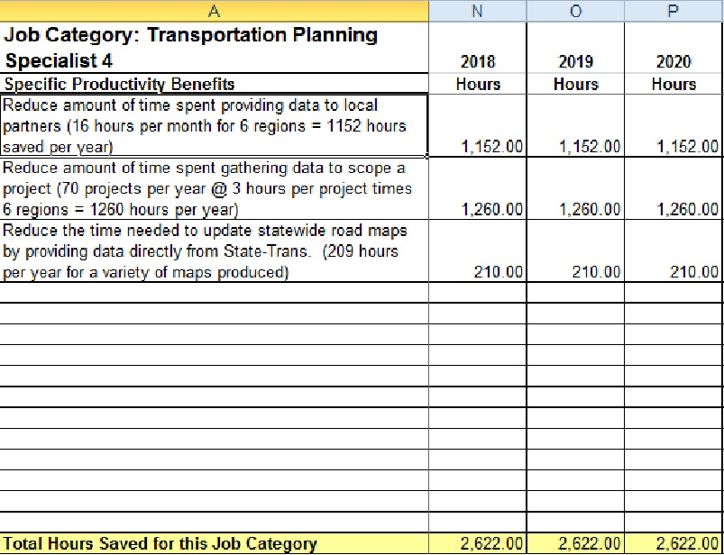
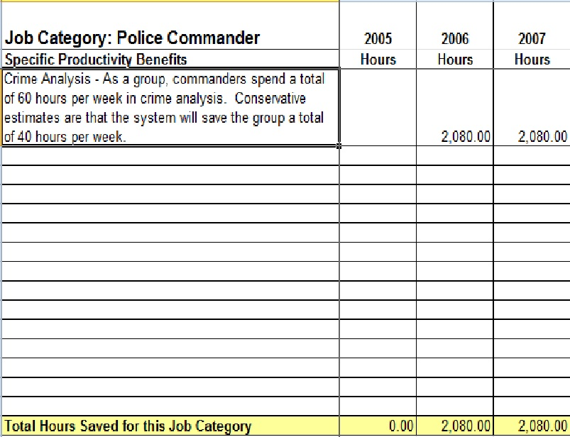
Other Examples of GIS ROI
Notes:
I’ve added some screen shots of other ROI studies based on a city-wide GIS system and a DoT data storage network to show other examples of return on investment. One of the prime uses of GIS is to have data “at your fingertips” for any location. Field visits are reduced or eliminated. Information is available to many through web or network access.

